Slide 1
[GNMDUJF001] - [Venue Booking System]​
POD Member Name
Shamini S 4. Ravi Teja Domakonda​
Bhamini Poorna Gurram 5. Bartick Chatterjee​
Dhanashree Patil​

Slide 2
Home Page
Venue Booking System
Login
Register
Image
Info about our service
2022 All rights reserved
About Us
Contact Us
2

Slide 3
Login Page
Venue Booking System
Login
User ID
Password
Sign In
2022 All rights reserved
About Us
Contact Us
3

Slide 4
Registration Page
Venue Booking System
Register
Email ID
Username
Firstname
Password
Lastname
Type of user
Customer
DOB
Dealer
Admin
Register
2022 All rights reserved
About Us
Contact Us
4

Slide 5
Venue Registration Page
Venue Booking System
Venue Registration
Venue Name
Location
Facilities Available
Halls
Auditoriums
Restaurants
Hotels
Register Venue
2022 All rights reserved
About Us
Contact Us
5

Slide 6
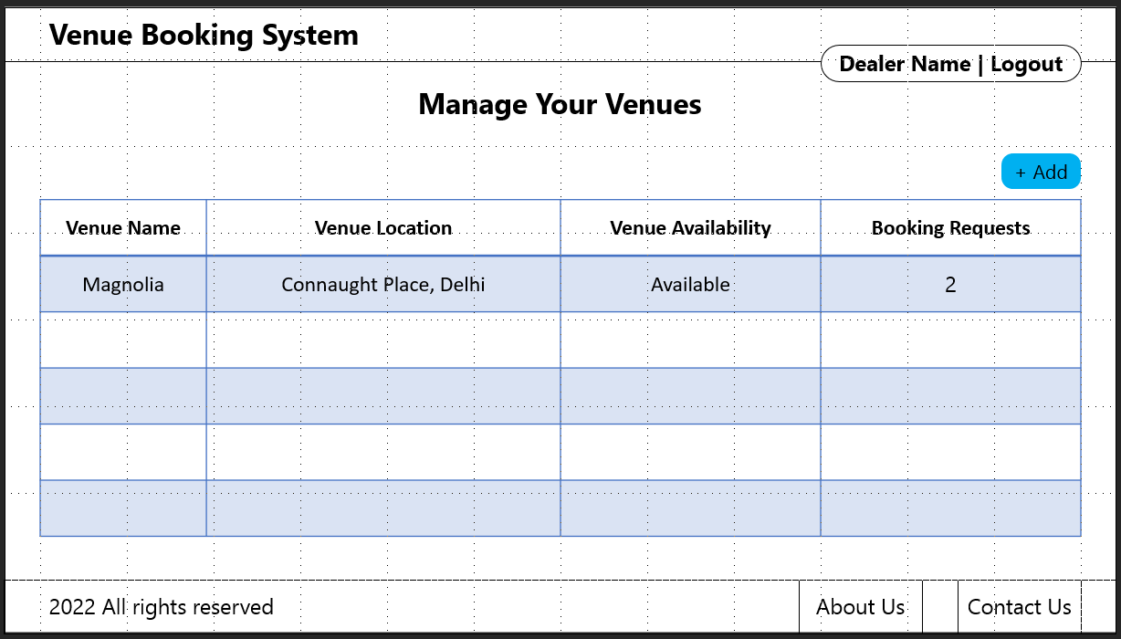

Venue Management Page
6

Slide 7
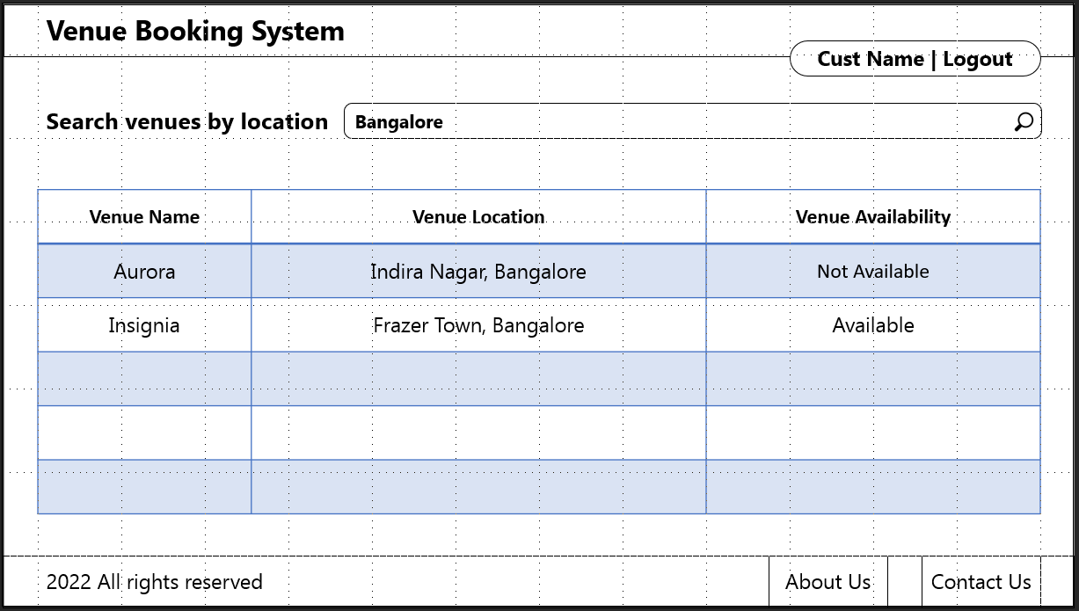
Venue Searching Page
7

Slide 8
Payment Page
Venue Booking System
Pay
Amount
Mode of payment
Pay
2022 All rights reserved
About Us
Contact Us
8

Slide 9
Thank You!
POD Member Name
Shamini S 4. Ravi Teja Domakonda​
Bhamini Poorna Gurram 5. Bartick Chatterjee​
Dhanashree Patil​

